Slide 1
Student-Centered Learning:
Room Design Matters
William S. Rayens
Department of Statistics
University of Kentucky

Slide 2
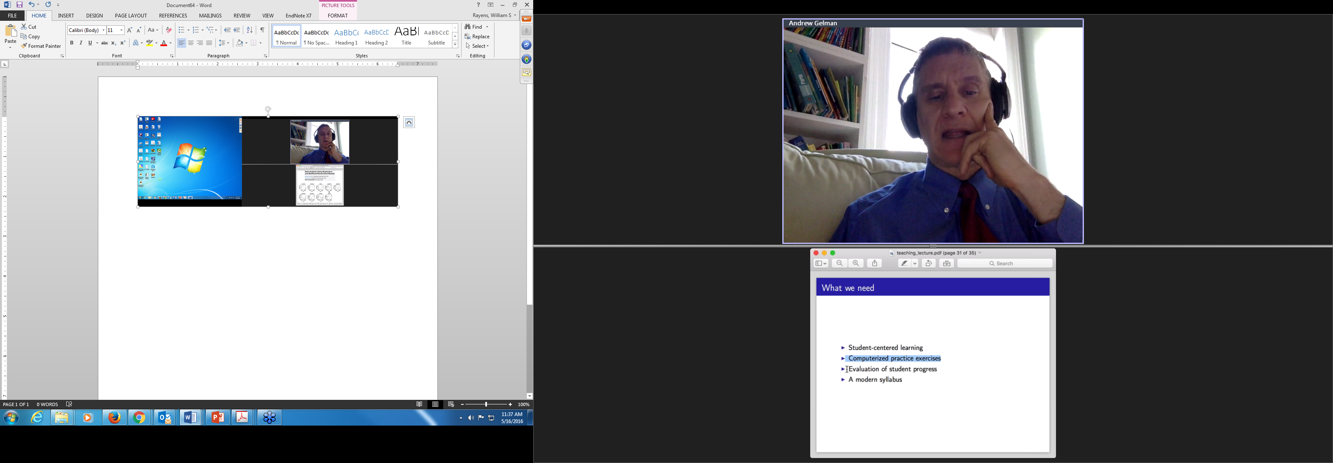
Conference Keynote
Motivational, funny, but a little off-putting and confusing at times.
Basic message is that we need to be student-centered.
Claim that we are currently teaching all the wrong material.
Implication that the right book will come out when he and co-author manage to write it.

Slide 3

Unfortunately
I am not as articulate or as smart or as funny as Dr. Gelman!
I do agree we need to be student-centered.
Dr. Gelman did express some strong opinions on how little our students are actually learning and retaining.
My colleagues and I share some of those same opinions at the University of Kentucky.

Slide 4
Working Definitions
Traditional Instructor-Dependent Classroom
  Students conditioned to rely on the daily injection of course material dispensed from the lectern in doses carefully calibrated to fill each scheduled class period.*
Student-Centered Classroom
  More student engagement, immersion and personal responsibility. Instructors are still relied on, of course, but more as coaches working the sidelines. Student self-reliance is promoted through a variety of action-oriented instructional formats that either replace—or support—traditional lectures .*
  *Some language borrowed from Colorado State University

Slide 5
Student-Involved Formats?
Open-ended problem solving requiring critical and creative thinking
Role-playing and participation in simulated situations
Non-traditional writing assignments
Collaborative team projects
Individual, self-paced assignments
Community engagement and Service-Learning assignments
  *List borrowed from Colorado State University

Slide 6
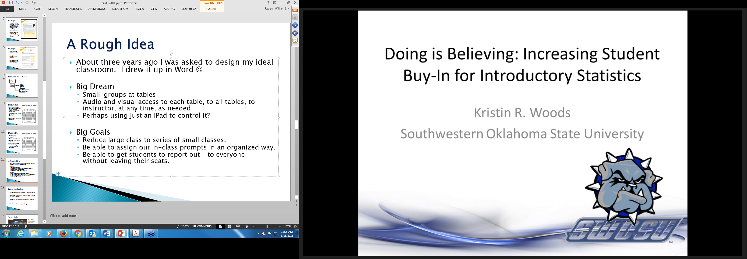
Consistent Theme in eCOTS

Slide 7
STA 210: Introduction to Statistical Reasoning @ U.K.
STA 210 has been using active learning, flipped, blended, student-centered approach for five years.
Have about 110 activities from a workbook Beyond the Numbers (Van-Griner)
Serves about 3500 students per calendar year, primarily in classes of size 130-135

Slide 8
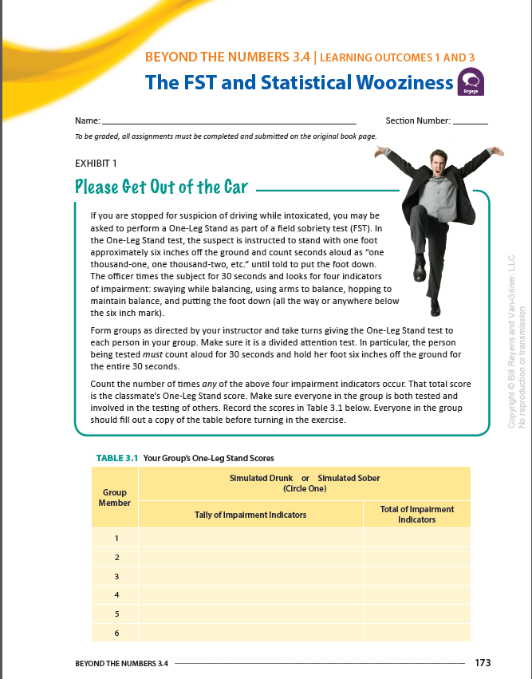
Example
Physically active exercises like field sobriety tests to generate data for sensitivity and specificity computations
Used to motivate language of hypothesis testing later on

Slide 9
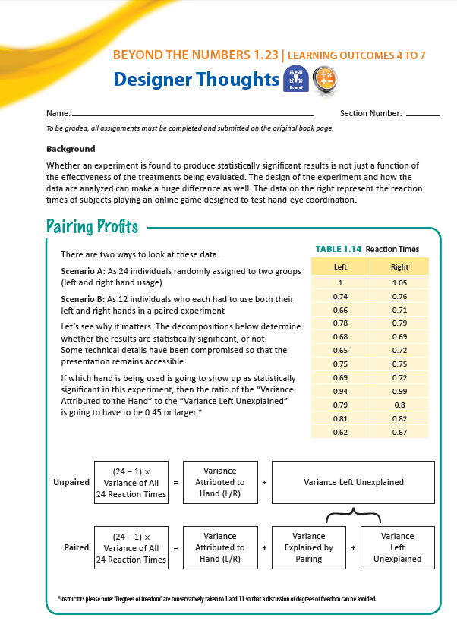
Example
In-place group exercises, such as understanding how pairing helps sharpen simple inference.
Want students to work together on these activities

Slide 10
Evolution for STA 210
Flipped
All activities
Blended
Some activities
Student-Centered
Worry less about language and more about focus
No lectures
Some ppts
Different talk entirely.
We will stay focused on classroom space.

Slide 11
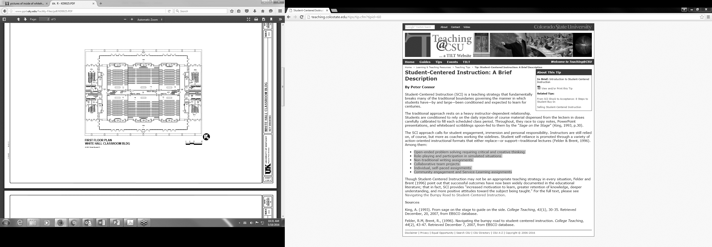
Lecture Halls
Whitehall Classroom Building 110
Most of our large STA 210 classes have been taught in rooms identical to what is shown here.
Designed in the 1970s for classic lecture formats.
Challenging to involve students.

Slide 12
Been Making Do
Floating mics
Clickers
Down-front demos
Hallway and outside activities
Think-pair-share
Using technology to help as much as possible

Slide 13
A Rough Idea
About three years ago I was asked by our Dean to design my ideal classroom. I drew it up in Word using shapes and text boxes!
Big Dream
  Small-groups at tables
  Audio and visual access to each table, to all tables, to instructor, at any time, as needed
  Perhaps using just an iPad to control it?
Big Goals
  Reduce large class to series of small classes.
  Be able to assign our in-class prompts in an organized way.
  Be able to get everyone involved at anytime. No where to hide!

Slide 14
Slowly Becoming a Reality
Started redesign of MDS 333 in summer 2014
Had tables and chairs in there a week into the fall 2014 semester
Had an ad hoc method of operation by early September
Full operation by spring of 2015 (+/- )

Slide 15
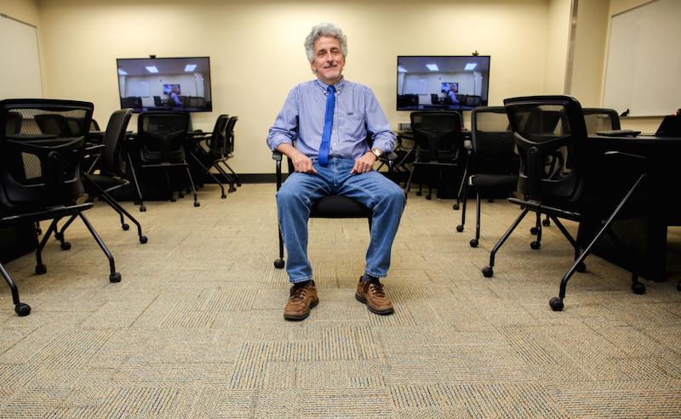
Architecture Enabled Grouping
Tables with large monitors, internet, and basic software access.
Six students per table.
Rooms in new $110 million Academic Sciences Building are modeled after this layout.
Photo Courtesy of College of Arts & Sciences, University of Kentucky
Notes:
.

Slide 16
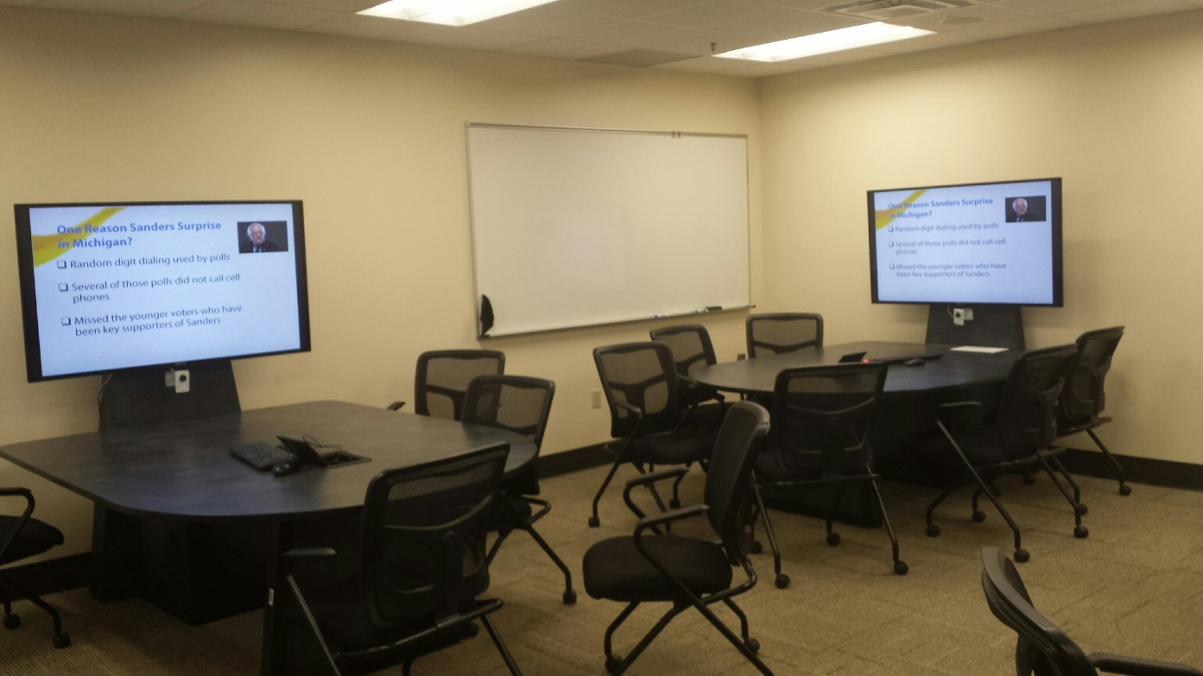

Technology Enabled Grouping
Traditional lectures can appear at each table.
More intimate. Less distraction.
Sound at each table.
Redeployed Traditional Use of Technology

Slide 17
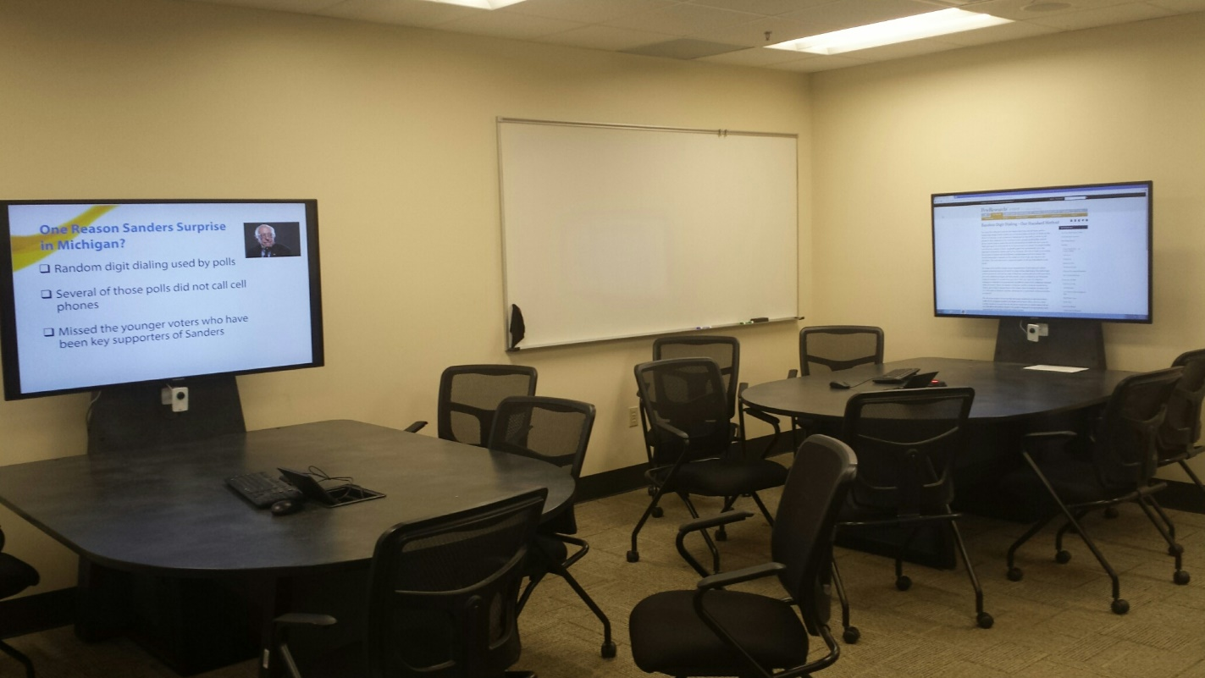
Technology Enabled Grouping
Individual tables can be released to work on their own
In this picture, the back table is researching random digit dialing on the internet
Group-Specific Use of Technology

Slide 18
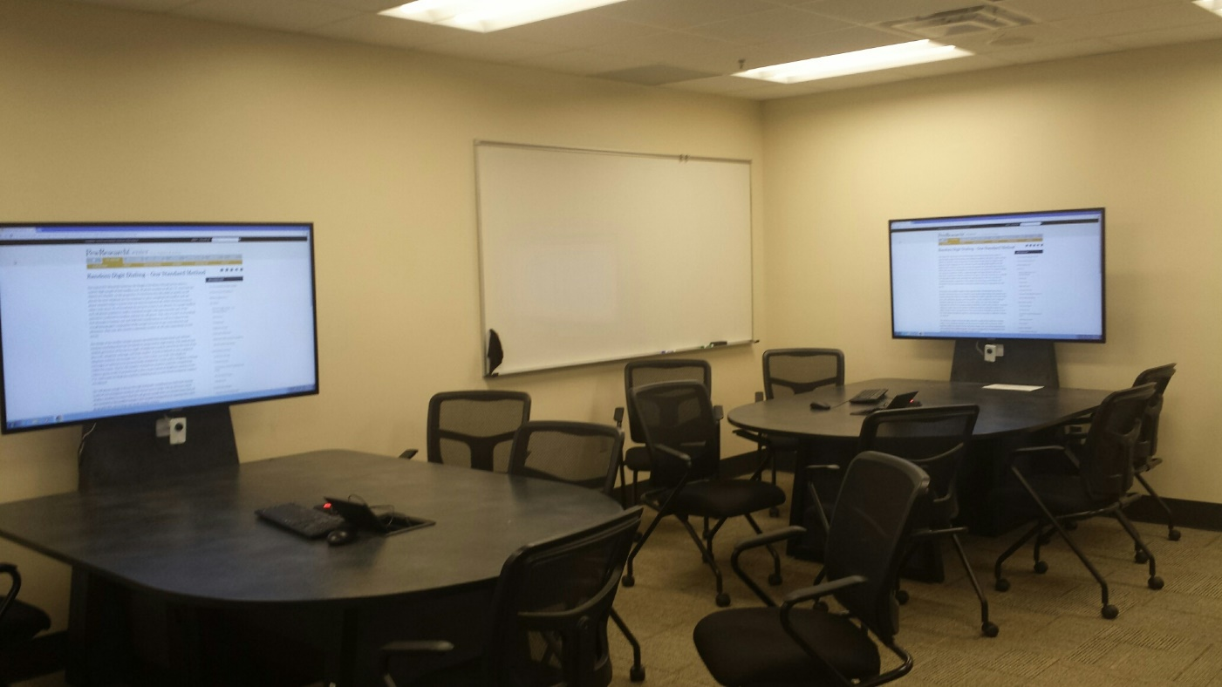
Technology Enabled Grouping
Individual tables can share their work with any or all of the other tables.
Cameras and microphones on tables can also bring more direct discussion to the room.
Group-Sharing Use of Technology

Slide 19
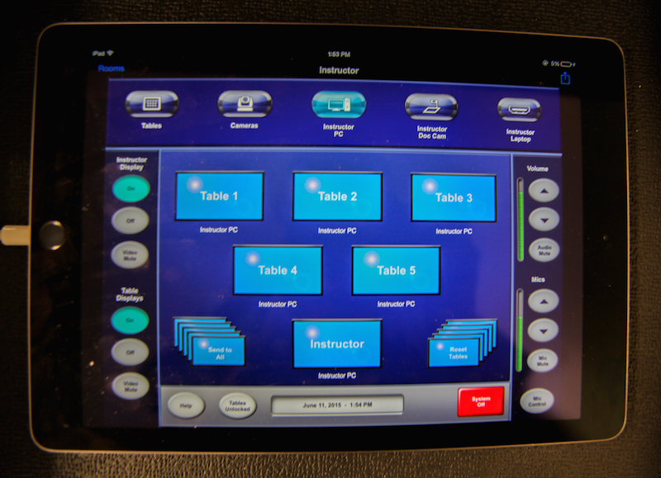
Facilitating the Grouping
Capability of the room controlled by an iPad
Design shown here is for MDS 333. Being redesigned for the new ASB rooms
Same idea though
Photo Courtesy of College of Arts & Sciences, University of Kentucky

Slide 20

What Happens at the Tables?
Give some examples from STA 210
Limited only by one’s imagination
And the realities of students in our environment

Slide 21

STA 210: Important to Know
Have a student-centered workbook with over 100 activities (BN = Beyond the Numbers)
Activities designed to be deployed different ways:
  as quick-exposure encounters with content
  as means of acquiring practical skills
  as vehicles for an in-depth encounter with a topic

Slide 22
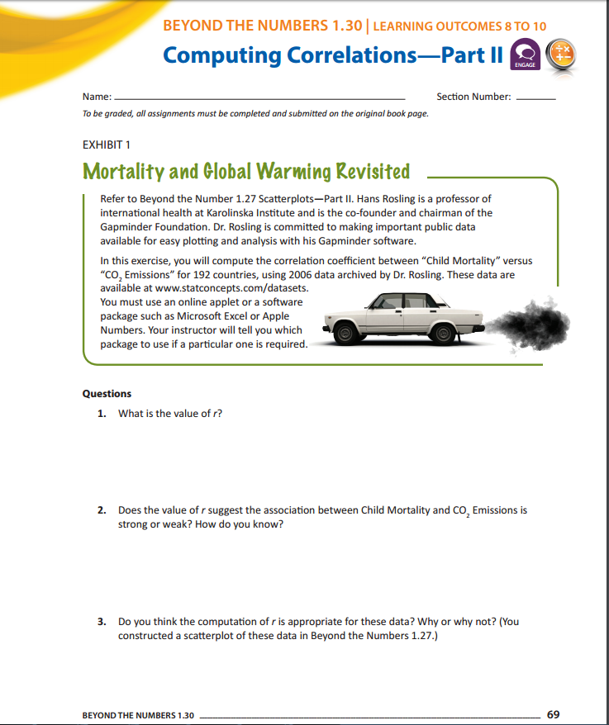
We’ve Experimented With:
Distribution of existing BN activities in group context
Creation of new group-specific prompts
Administration of group quizzes
Use of group clicker activities
Various reporting-out strategies for groups

Slide 23
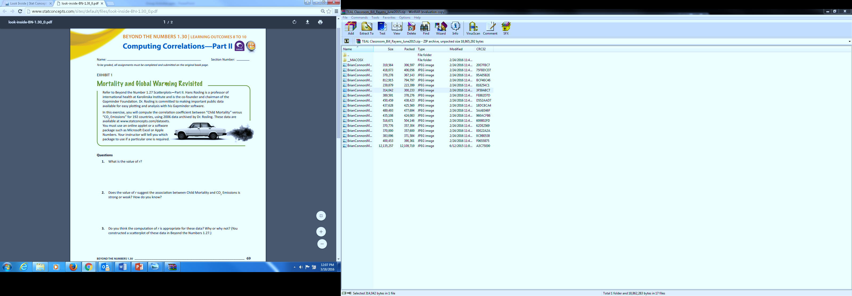
Rudimentary Task ≠ Easy Task
Tasks involved:
  Go to book website and get the data set
  Use the internet or group knowledge to uncover function in Excel for computing r.
  Apply the function to the data under study.
These self-directed kinds of activities have long been a problem for some students and we’ve found the small-group tutorage has been helpful.

Slide 24
Practicing New Language
Tasks involved:
  Make connections with content examples that were supposed to be viewed outside of class.
  Make connections to previous activity designed to set this one up.
  Practice using a new language.
Initial indications are that the group tussles over the right way to make these reasoning connections have been useful in surfacing anticipated weak spots.

Slide 25
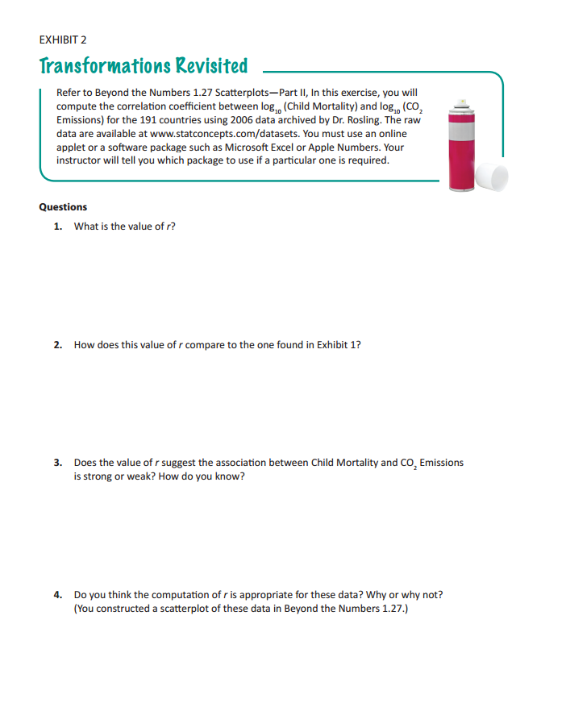
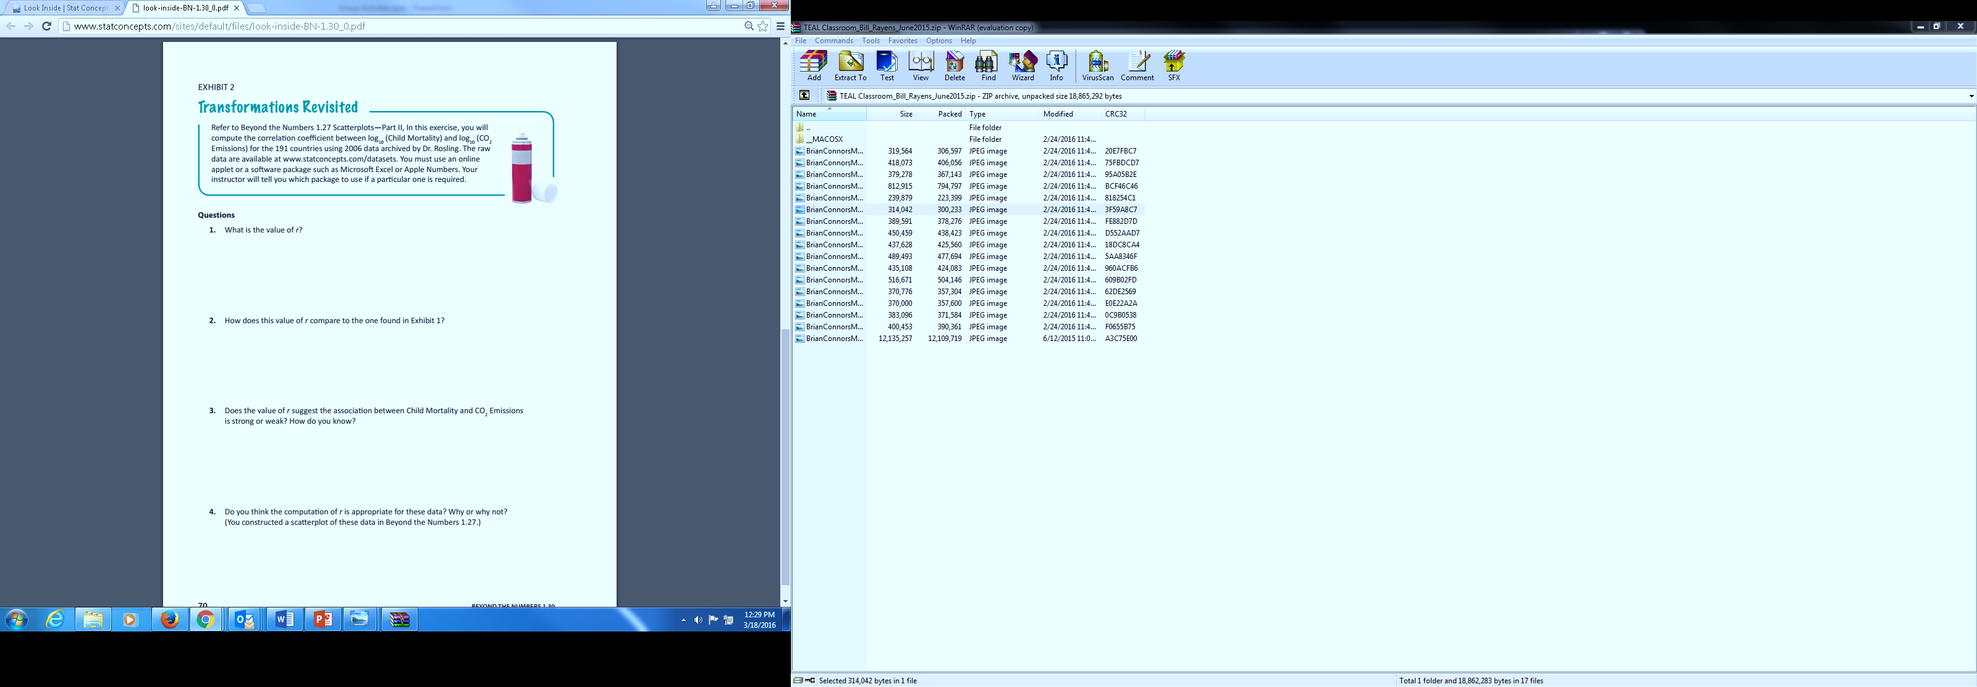
Raising the Bar
Tasks involved:
  Computational
  Conceptual
Often very difficult for many in STA 210. Hoping group discussion helps. Seems to.
May do this kind of activity in class, and then assign a similar one for homework.

Slide 26
Distribution of Hands-On

Slide 27
Distribution of Hands-On
Goals
  Replace the “demonstration-down-front” we used to use
  Get every students’ hands on the materials
  Create a safe environment for participation
Very limited data from just two semesters, but students tended to enjoy these a lot.
Does enjoyment translate to learning?
Notes:
In the past we have attempted to do these kinds of demonstrations with students at the front of the lecture hall. It’s not the same. Better for each table to work on their own activity, after which I attempt to pull together what we have learned from each.

Slide 28
Send to the Internet
Table 1 – Discuss how Cosmo polls are taken and comment on how they compare to SRS.
Table 2 – Look up random digit dialing (common with reputable polls) and comment on how this is SRS like.
Table 3 – Look up “snowball sampling” and tell us about it. Is it SRS like?
Table 4 – If you were going to sample people in your living area, how would you do that?
Table 5 – Do you think on-line reviews are statistical samples (e.g. at Amazon)? Why or why not? Can you think of a way to make online reviews more useful?
Goals:
  Have students encounter ideas we know they’ll need later in the material (e.g. on their capstones)
  Force discussion of these ideas within the small group structure

Slide 29

What Have We Learned?
Need to limit scope of prompts.
Reporting out is ticklish, especially if you are wanting everyone in the class be responsible for a correct version of what the are hearing from their peers.
Have to allow time at some point to clean up what the groups say.
Found it was more effective to break up a single prompt into parts once reporting out starts. That way the entire group stays focused on the same ideas.

Slide 30

Everybody Does Same Thing
Go to this applet: http://www.rossmanchance.com/applets/NormCalc.html . Please play around with the applet to figure out how to do the following:
Find the z* value for an 85% confidence interval.
Find the z* value for a 30% confidence interval.
Using this ring and this makeshift peg/post, please do the following:
Construct and demonstrate an activity that illustrates the correct interpretation of a confidence interval.
Explain why the interpretation in Statement 2 in BN 2.20 is incorrect (in the context of your activity of course).
When tables report out, everyone is on the same page with respect to the activity.

Slide 31
So Much to Say, So Little Time
Required tables to take quizzes as group at beginning of each class (on Canvas).
  Canvas not great for this.
  Still like the idea and will probably continue it.
  Like the pressure it creates in the groups to listen and contribute.
Had tables assigned to a clicker for Turning Point activities.
  Similar goal as above. Trying to force discussion and peer learning

Slide 32
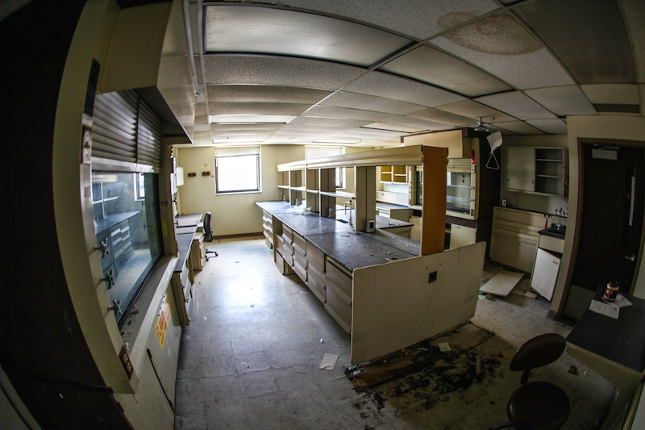
Converted Abandoned Lab
Renovation was expensive.
Had to convince many people it was worth it.
Ended up having to fund much of the renovation from the Department.
In the end, the design became the model for all the TEAL (technology-enhanced active learning) rooms in the new ASB.
Flat, open ballroom with internet access a good start.
Photo Courtesy of College of Arts & Sciences, University of Kentucky

Slide 33
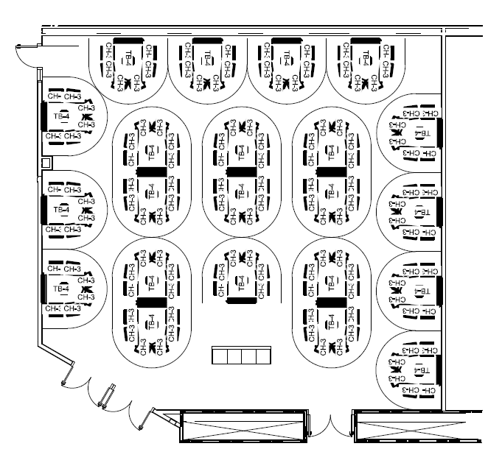
Academic Sciences Building
Opening in August 2016.
STA has largest TEAL room.
132 seats, 22 tables of 6.
All the technology we have in the little MDS room.

Slide 34
In Summary
What I Know
  Maintaining a student-centered classroom is hard.
  Burnout a problem for instructors.
  Students may perceive you as working less!
  Most honest teaching for me in over 25 years.
  No way I would turn (completely) back.
What I Think
  Room design is a game-changer. Creates a student-centered environment for you to work with.
  Makes it a bit less of a chore for the instructor.
  Can’t really separate talk of “changing everything” from a discussion of the classroom space.

Slide 35
Questions?
Email: rayens@uky.edu
Please, come see MDS 333 anytime. And come see the new Academic Sciences Building when it is open.
Perhaps we should have a follow-up meeting there during the 2016/17 academic year.
STA 210 workbook, sample syllabi, class schedules, FAQs, more - available at van-griner.com

