Slide 1
Reflections on Using Simulation Based Methods to Teach Statistical Methods
Amanda Ellis and Melissa Pittard
University of Kentucky, Department of Statistics

Slide 2
Official Course Description
Introduction to principles of statistics with emphasis on conceptual understanding. Students will articulate results of statistical description of sample data (including bivariate), application of probability distributions, confidence interval estimation and hypothesis testing to demonstrate properly contextualized analysis of real-world data.

Slide 3
Who is Teaching?
Notes:
1 Lecturer and 3 Instructors
The class size is approximately 150 students. Students meet in smaller sections once a week.
2 TAs are assigned for each class of 150.
2 Primary TAs
The class size is approximately 75 students. Students meet in smaller sections once a week.

Slide 4
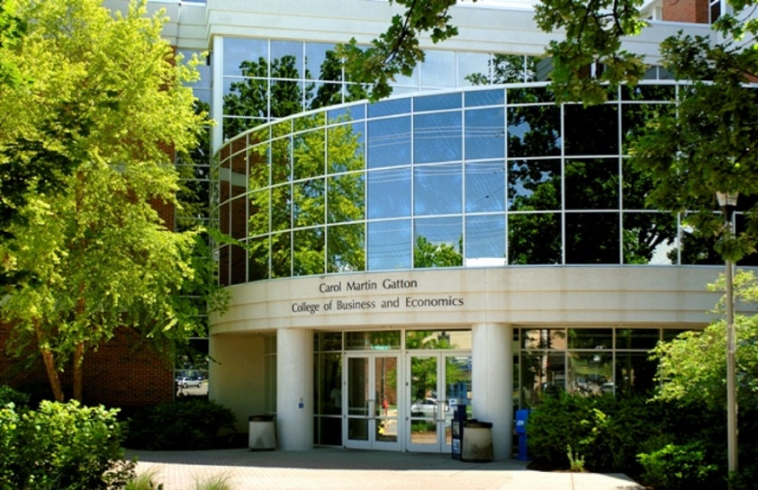
Who is Taking the Course?
Notes:
Approximately 850 students in the fall and spring
Approximately 150 in the summer
Majority of Students are Sophomores and Juniors
Majority of students are business majors

Slide 5
Where is the course being taught?
Notes:
Approximately 850 students in the fall and spring
Approximately 150 in the summer
Majority of Students are Sophomores and Juniors
Majority of students are business majors

Slide 6
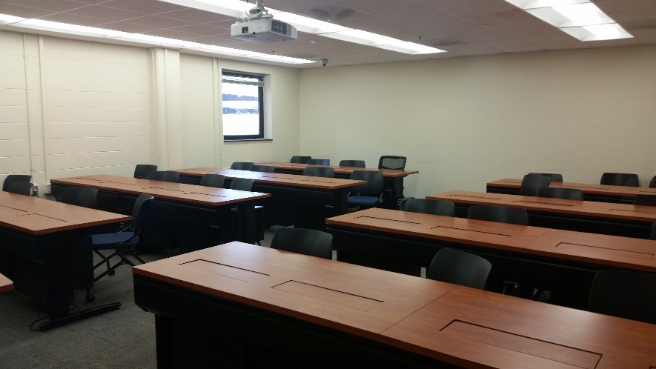
Notes:
Approximately 850 students in the fall and spring
Approximately 150 in the summer
Majority of Students are Sophomores and Juniors
Majority of students are business majors

Slide 7
How was the course previously taught?
Notes:
Approximately 850 students in the fall and spring
Approximately 150 in the summer
Majority of Students are Sophomores and Juniors
Majority of students are business majors

Slide 8
Motivation for Transition
Notes:
Statistical Inferential Reasoning These courses will encourage students to evaluate claims based on statistical principles by providing an understanding

Slide 9
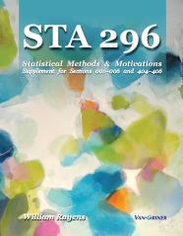
Course Materials

Slide 10
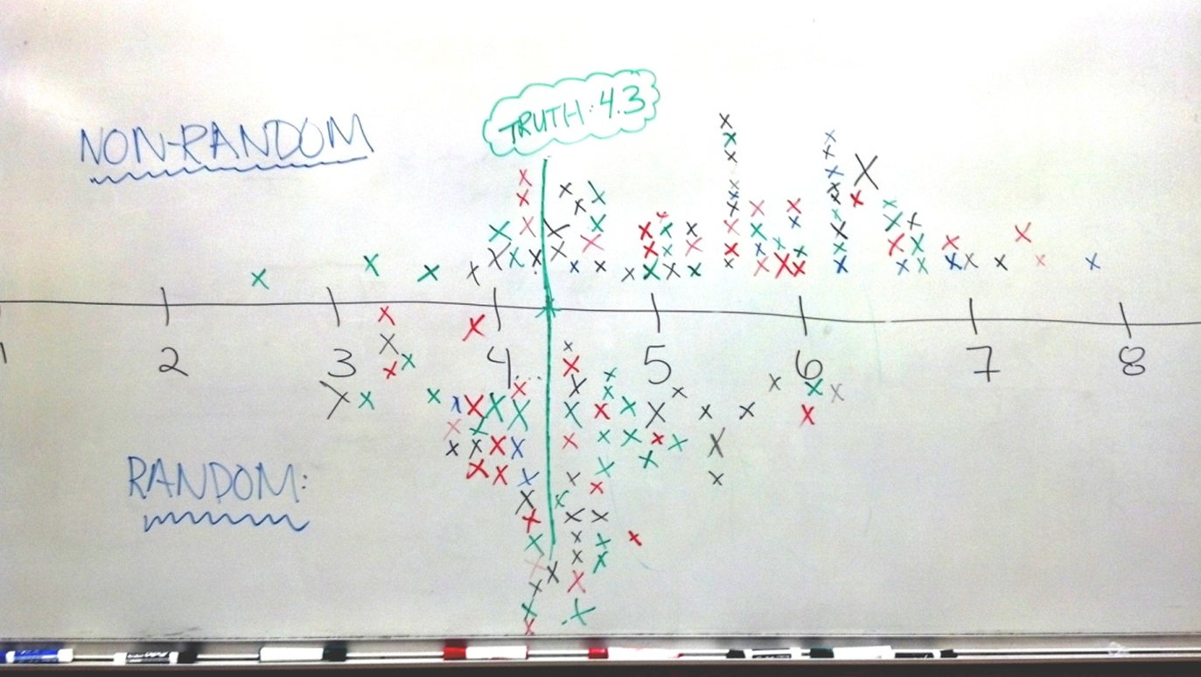
Standard Error

Slide 11
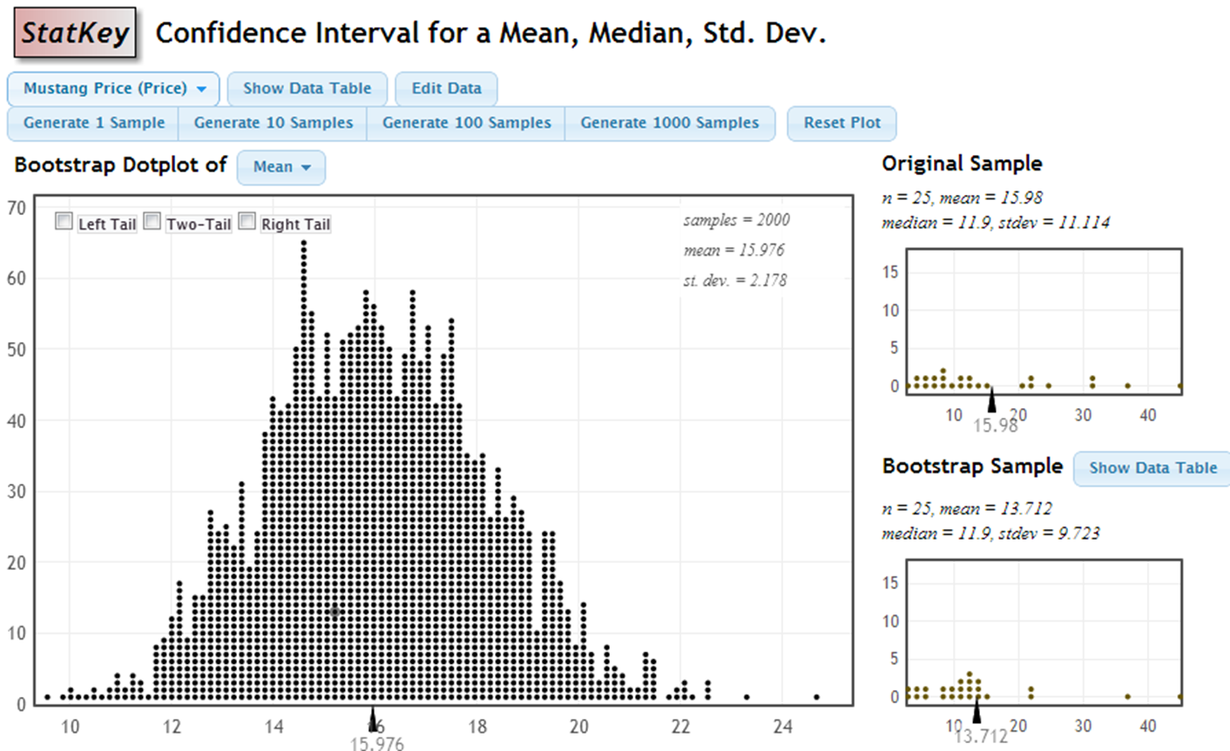
Bootstrap Distribution

Slide 12
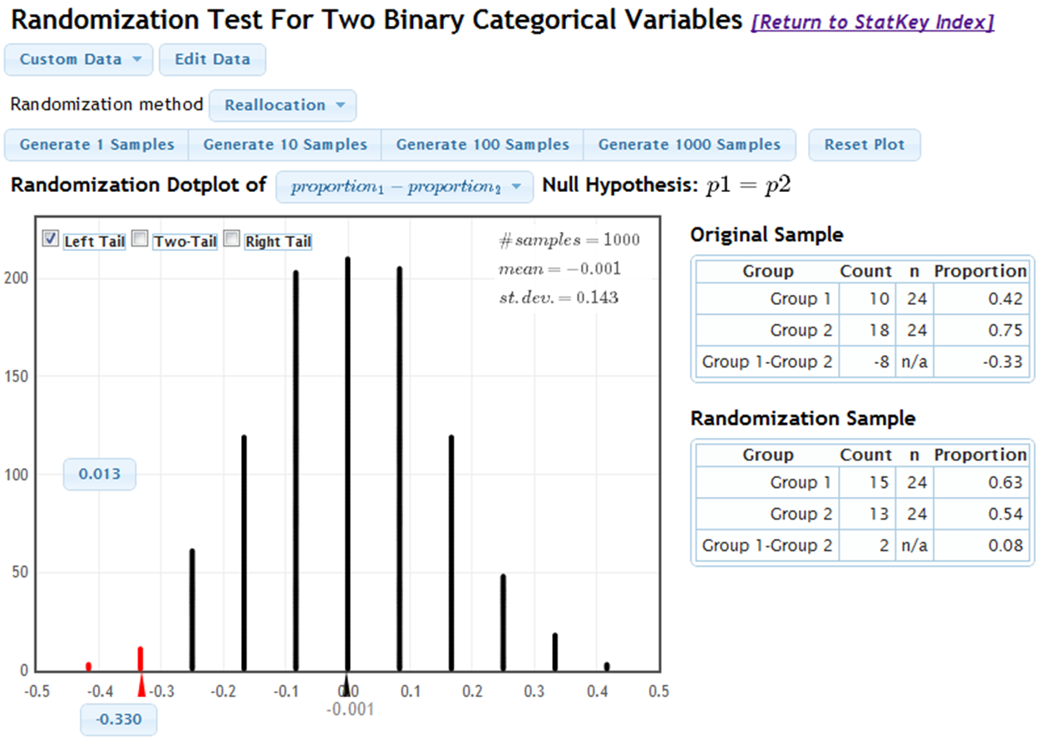
Hypothesis Testing

Slide 13
Formulas

Slide 14
Impressions
Notes:
Statistical Inferential Reasoning These courses will encourage students to evaluate claims based on statistical principles by providing an understanding

Slide 15
Are we benefitting students?
I think that it has greatly benefited students. Their final projects reflect a much deeper understanding of statistical inference than before the change.
Generally, it seems to benefit students who pretty motivated to begin with -- that group seems to grasp the idea of standard error really well now. It doesn't seem to have much of an effect on less motivated students.
Other than getting to inference a little sooner in the semester, I'm not sure if simulation based methods has really benefited students. Since we learn the simulation methods and then traditional methods, a lot of students feel like we are just repeating ourselves the entire second half of the semester.
I honestly think it can be quite confusing for the students. Without a good foundation on probability (probability distributions in particular) it can be hard to make the transitions from simulation to theoretical distributions.

Slide 16
How has teaching changed?
I am lecturing less and asking students to work more.
I lecture less than I used to. I don't think watching me create bootstrap distributions and randomization distributions repeatedly is all that beneficial -- I would rather give the students more simulation-based questions to work on.
A little less lecturing so they can go through some simulations in class/lab.

Slide 17
Do we recommend the simulation based methods?
Yes. I think that the simulation-based methods along with introducing inference early on in the course gives students a better opportunity to grasp the difficult concepts associated with inference.
Sure. It seems to help some students gain a deeper understanding of the conceptual material in the course, and it certainly doesn't seem to make it more difficult for others. The one part of it that I might not recommend is explaining how the different randomization distributions are constructed -- some of those distinctions might be a little fine for a first-semester methods course.
Maybe. Still need more time to decide. I like it but maybe not as much as we do now.

Slide 18
Overall Comments
The transition from simulation-based estimation/inference to CLT-based estimation/inference is kind of awkward. Most students view those as two separate topics, not the same things done two different ways. The transition seemed a lot smoother using probability as a lead-in to the CLT-based material.
I do not feel like this is the "savior" of intro stats courses, but a powerful tool to aid in comprehension of statistical inference. As we now have so much technology at our fingertips, we can certainly make wise use of it in our classrooms. Care must be taken though to not have technology get in the way of learning.

Slide 19
What next?
Notes:
Statistical Inferential Reasoning These courses will encourage students to evaluate claims based on statistical principles by providing an understanding

Slide 20
New Classroom
Notes:
Statistical Inferential Reasoning These courses will encourage students to evaluate claims based on statistical principles by providing an understanding

Slide 21
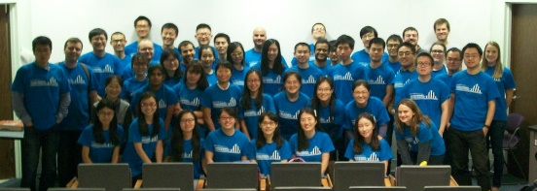
New TA roles
Notes:
Statistical Inferential Reasoning These courses will encourage students to evaluate claims based on statistical principles by providing an understanding

Slide 22
New Software
Notes:
Statistical Inferential Reasoning These courses will encourage students to evaluate claims based on statistical principles by providing an understanding

Slide 23
Thank You!

